Slide 1
GAN & DCGAN
資工系 李彥儒

Slide 2
Outline
GAN
DCGAN
Comparison
Mode collapse
Summary

Slide 3
GAN
Prepare the dataset
Build the GAN model
Optimize the networks
Generate new images
– Kaggle Cats faces 64x64
Notes:
Kaggle Cats faces 64x64 (15000 images) For generative models, so no labels on the images
https://www.kaggle.com/datasets/spandan2/cats-faces-64x64-for-generative-models?resource=download

Slide 4
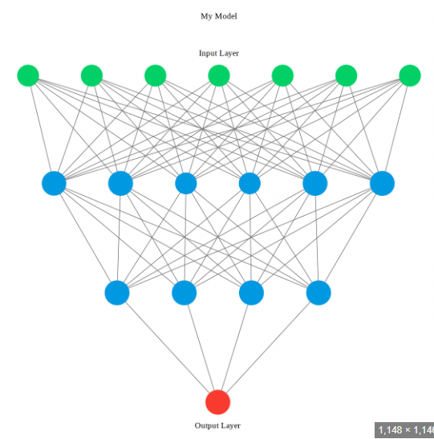
Parameters
Epochs = 250
Batch size = 64
Learning rate = 0.0002
Learning rate beta1 = 0.5
Learning rate beta2 = 0.999
Image size = 64
Channels = 3 #colorful dataset
Latent dimension = 128
Interval = 500 # How often to sample

Slide 5
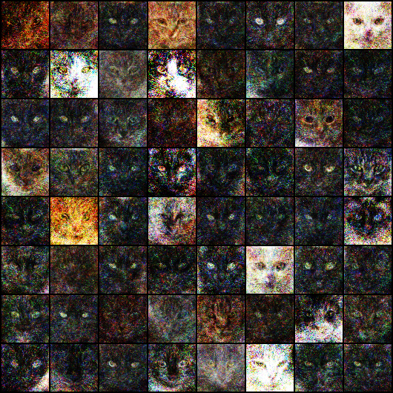
Result
Blurred
Repetitive

Slide 6
DCGAN
Deep Convolutional GAN
Fully connected layers → convolutional layers
Convolutional layer (torch.nn.Conv2d)
- extracting features from an input image
Deconvolutional layer (torch.nn.ConvTranspose2d )
- generating new data from a learned representation

Slide 7
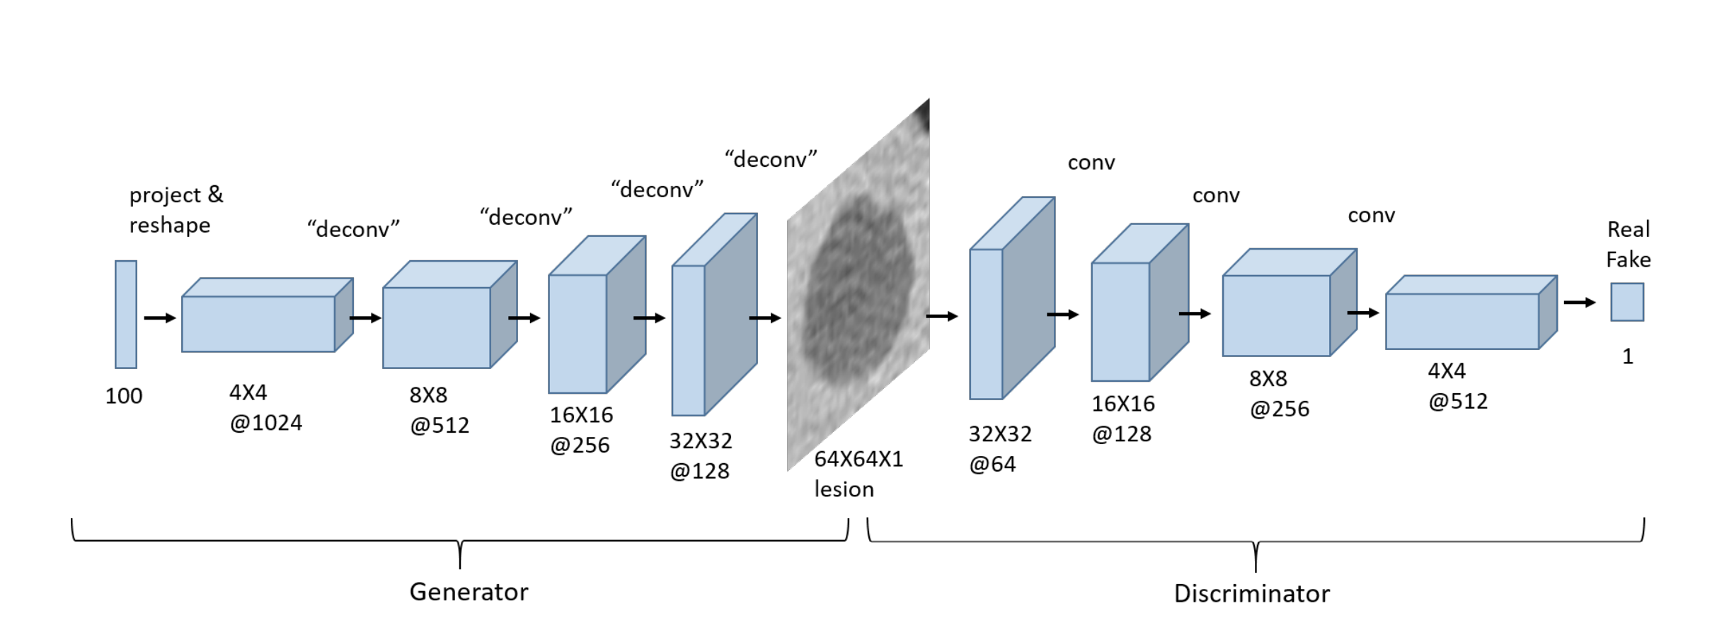
Model
Notes:
https://freecontent.manning.com/practical-applications-of-gans-part-1/

Slide 8
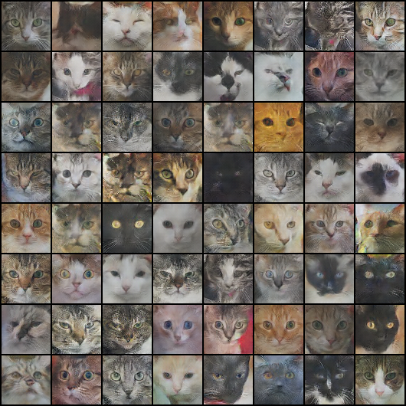
Result

Slide 9
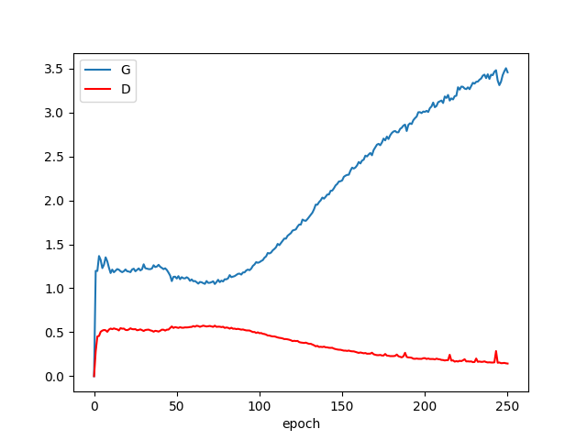
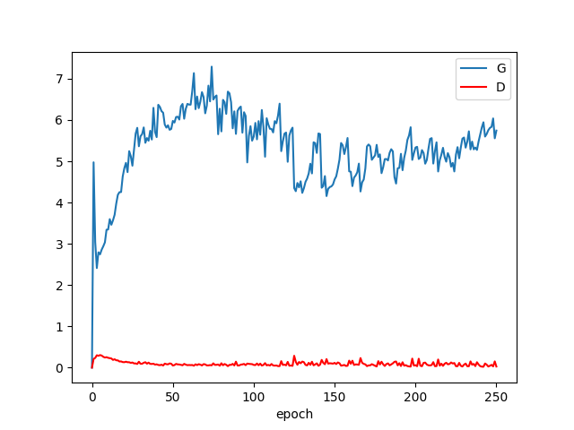
Comparison
GAN
DCGAN

Slide 10
Mode Collapse
Generator's loss is increasing continuously
- Not producing diverse outputs
- Discriminator can easily learn to distinguish
Discriminator's loss is decreasing
- Discriminator is too powerful and the generator is unable to keep up
Notes:
the discriminator can easily learn to distinguish between the generated images and the real images, causing the generator's loss to increase.

Slide 11
Visual inspection
Generated images
- Repetitive and lack diversity

Slide 12
Summary
What I have learned
- GAN, DCGAN model details
- Tuning parameters
What I can do
- Avoid mode collapse:
1. Evaluate the model’s performance with various metrics
2. Additional penalties to modify the generator loss
Notes:
The generator loss can be modified to include additional penalties for generating similar images, or the architecture of the generator can be modified to encourage diversity in the output.
Evaluating the performance of the model using various metrics like Inception Score, Frechet Inception Distance, or diversity measures can provide insights into whether the model is suffering from mode collapse.

Slide 13
Reference
https://towardsdatascience.com/getting-started-with-gans-using-pytorch-78e7c22a14a5
https://www.kaggle.com/datasets/spandan2/cats-faces-64x64-for-generative-models
https://freecontent.manning.com/practical-applications-of-gans-part-1/
https://chat.openai.com/

Slide 14
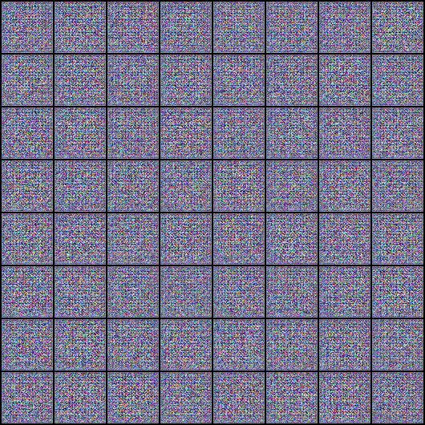
THE END

